Slide 1
Anonymous Delegates and Lambda Expressions
IN710 OOSD 2017
Session 9.1
Notes:
Useful extensions of the delegate technique

Slide 2
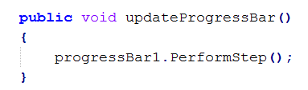
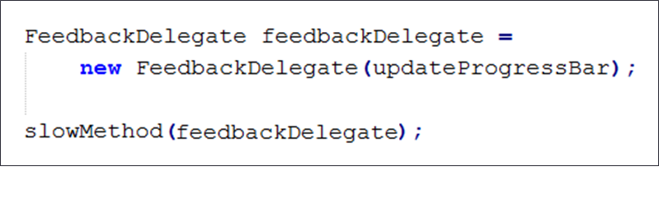
Basic Delegates
Notes:
So we wrote this code
You defined the delegate type, then built a method to match the delegate type, then created one of them, then finally passed it into the method that needed it.
But people decided that this was a lot of effort to pass in one line of code (progressBar1.PerformStep()). If the helper method was 100s of lines, it would be efficient this way, but for one line it seemed like a lot of overhead.
So C# 2.0 introduced a shorthand for delegates called “anonymous delegates” with which you don’t have to make a separate declaration of the method to associate with the delegate instance, you just sort of declare it when you need it. (Those in Mobile and Web 3 will recognise the similar features in Android and JavaScript.)
The anonymous syntax feature will allow us to eliminate the definition of the method, and the creation of the delegate instance via “new”
We will replace the new statement with the actual code.
Like this…

Slide 3
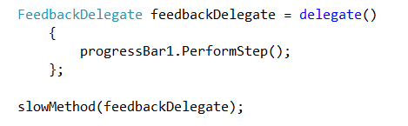
Anonymous Delegates
Notes:
Assuming delegate type FeedbackDelegate has been declared as before….
We no longer have the names function or the new statement.
The delegate() keyword says “here comes the code of the delegate”.
Note that the input args (in the delegate()) and the output return value still have to be appropriate for the delegate type.
Here, delegate() has the empty arg list, and the single line of code has no (i.e. void) return as required by FeedbackDelegate.
Given that you match the delegate type, you can write all the code you need in the anonymous declaration.
We will see an example with some more in a moment…
The delegate instance thus created is then passed to slowMethod in exactly the same way as before
Note the terminating semi-colon in the anonymous delegate creation. That’s required.

Slide 4
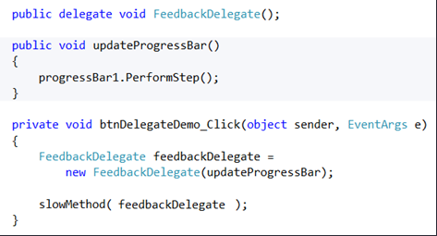
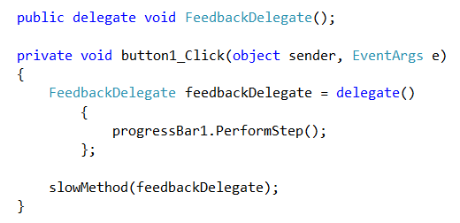
Comparison
Notes:
Just to reiterate: Method 1 (Delegate instance) and Method 2 (Anonymous delegate)
Note that you can do this wherever you would have supplied a concrete delegate instance.
For example….

Slide 5
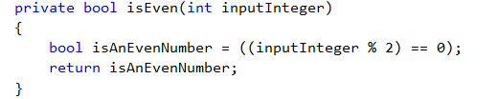
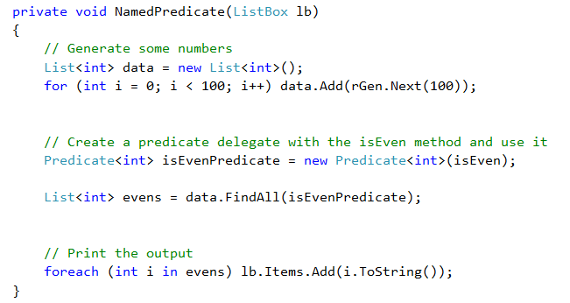
Anonymous Delegates
Notes:
Remember this? Hopefully, you have written this code.
This function matches the method signature for the system delegate Predicate<int>
So we can do things like this….make an instance and pass it to a method like findAll, who wants one
But we can also do it like this…

Slide 6
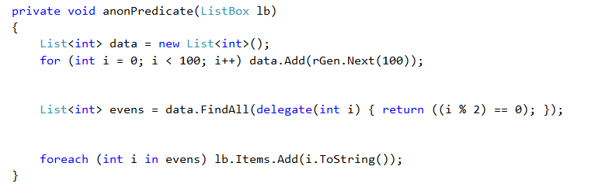
Anonymous Delegates
Notes:
It is also legal to do it like this.
We don’t declare the isEven function at all.
We don’t create an instance of the delegate.
We just get to the point where findAll wants a predicate delegate, and start writing the code.
Thoughts? Less typing? => Yes. Readability problems? => Also yes.
Use with caution.

Slide 7
Lambda Expressions
General form:
inputs => output function
Example:
x => x * 3 // equivalent to f(x) = x*3
Example:
(x, y) => x != y
(int x, int y) => x != y
Notes:
Should be familiar from Programming 4
With C# 3.0 the trend toward more succinct code continued as they decided that even anonymous methods required too much typing.
So they introduced the lambda expression
These are mathematical constructs from the lambda calculus, an important theory of functions.
They are a critical part of functional programming languages, which are a completely different kind of programming tool than the ones we use.
They can get a lot more complicated than we are going to see today, and we may come back and revisit them later.
In these languages there is no sense of “first do this, then do that”. All processing is defined as functional relationships.
Lambda expressions simply define functions
The => operator is read as “goes to”
The first is equivalent to f(x) = x*3
The second evaluates to true or false. Equivalent to if(x!=y) return true; else return false;
If necessary you can specify the data types as shown, but generally the compiler will infer the type and behave accordingly.
In some cases, you can tell that the compiler won’t be able to tell what type your arguments should be, and you will have to specify it. We will see an example in a minute.

Slide 8
Lambda Expressions
Any anonymous delegate can be replaced with an equivalent lambda expression.
Notes:
So this gives us three ways to specify a function argument: explicit delegate instance, anonymous function and lambda.
Let’s compare…

Slide 9
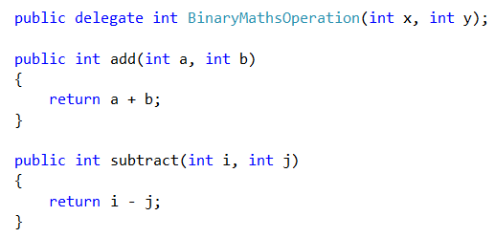
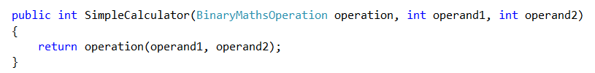
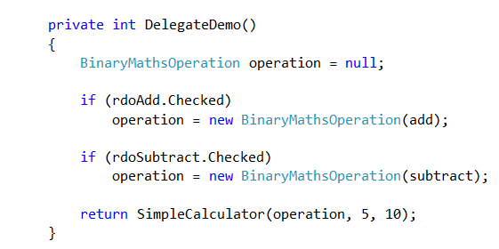
Concrete Instantiation Version
Notes:
Remember this?
Let’s look at doing this with anonymous and lambda…
First, with anonymous methods, we can get rid of the add and subtract methods, completely.
SimpleCalculator is the consumer, he remains the same.
In DelegateDemo, where we call SimpleCalculator, we don’t create any instances anymore, but just declare the delegates anonymously on the fly.
So what does DelegateDemo look like?

Slide 10
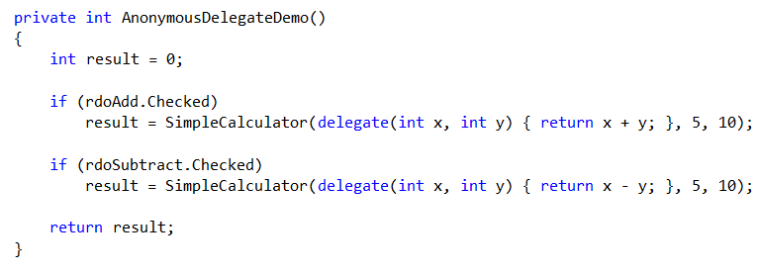
Anonymous Version
Notes:
(Walk through)
Remember that the add and subtract methods are gone.
And the DelegateDemo method has fewer lines.
So you have saved some typing. What do you think about the readability?
Any limit on when you might use this syntactic feature?
We said earlier that any anonymous delegate could be replaced with a lambda.
What would that look like here?

Slide 11
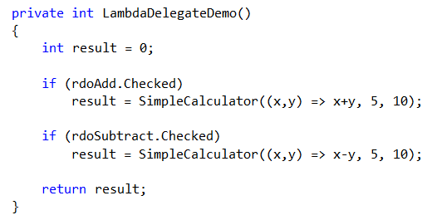
Lambda Version
Notes:
Here we need no “delegate” keyword, no “return” keyword, and no data types, since they can be inferred from the operator.
(Just a thought, what do you think you would do if you wanted concatenation instead of addition in this lambda?) => Explicitly type your input args
Let’s look at some more lambda expression examples.

Slide 12
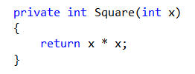

Lambda Examples
Notes:
How would you write this function as a lambda?
The full lambda syntax allows specification of type, the return keyword, braces, the whole lot.
In fact, you can write more complicated lambdas that have if statements and so on, but by the time you get there, you might as well write the code

Slide 13
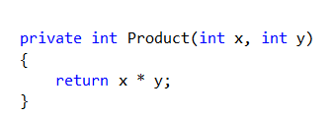

Lambda Examples
Notes:
How would you write this function as a lambda?

Slide 14
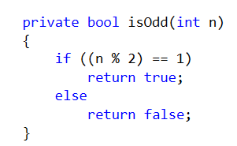

Lambda Examples
Notes:
How would you write this function as a lambda?

Slide 15
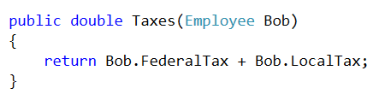

Lambda Examples
Notes:
Assume class Employee exposes these properties
How would you write this function as a lambda?
Input b goes to....

Slide 16
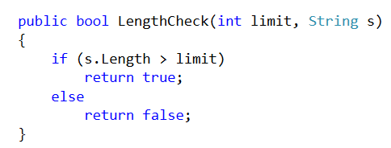

Lambda Examples
Notes:
How would you write this function as a lambda?
Let’s look at how this would actually happen in code....

Slide 17
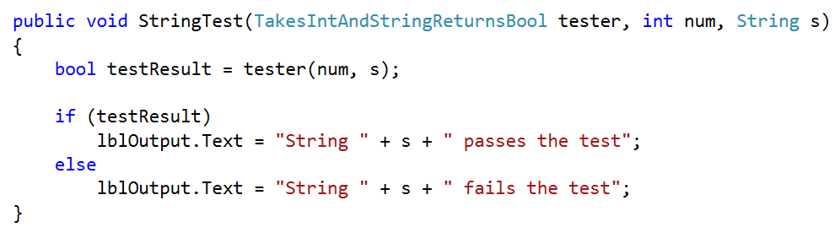
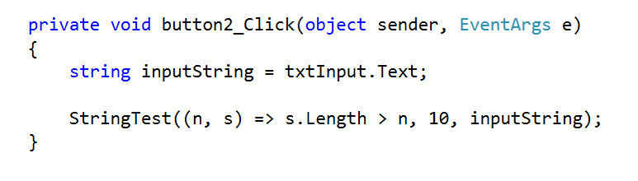
Lambda Examples
Notes:
There’s the lambda up in the corner for your reference.
Read it as “takes n and s and goes to (returns) true if s.Length > n, false otherwise”
Declare a delegate type that matches this signature: takes an int and a string, and returns a bool...
Write some method that wants a delegate of that type....
Note how general the functionality is. This method doesn’t care what you are doing with the number and the string. It will simply tell you whether the function returns true (which it considers a ‘pass’) or false (which it considers a ‘fail’). (Should note that mathematically, Takes...Bool is a predicate.)
We could create an instance of TakesInt…Bool with any function that matched the delegate signature. The LengthCheck function on the previous slide, for example, would work fine. We could then call StringTest and pass that instance in as the first argument.
But as we now know, we could also just write that function anonymously on the fly when we call StringTest (left as an exercise)
StringTest(delegate(int n, string s) { return s.Length > n; }, 5, "afg");
Or, we could call StringTest and give its tester function with lambda, like this

Slide 18
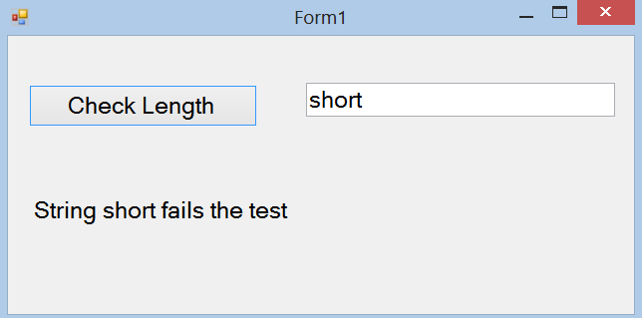
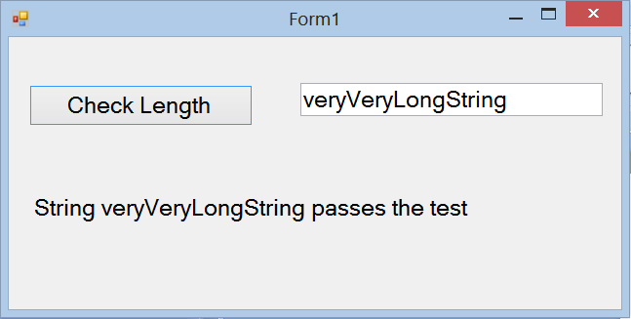
Lambda Examples
Notes:
The program...

Slide 19
Lambda Functions
public delegate TResult Func<in T, out TResult>
Notes:
The lambda syntax can also be used to create a named function, using the Func<T,T> system delegate
The first n-1 args “in T” represent the input variables. Provide a comma-separated list.
The last arg “out TResult” is the return type.
You can create a named function with a lambda like this one to convert RPM to KPH (cf. the exercise bicycle subject/observer practical).
RPMtoKPH is a delegate. It can be declared in local or global scope (i.e. inside a method or just in the body of the class)
You then call it in the normal way...
There is another, more complex delegate type for lambda Expression<T,T> that provides a different in-memory representation which is more efficient for complex calculations. See the docs if interested.

Slide 20
Practical Exercises
Due before class on Thursday
Notes:
As described, lambdas don’t seem to accomplish much beyond saving some keystrokes.
But there is another C# facility where they come in very handy. This is an alternative C# syntax for collection processing (called LINQ) where we need to be able to embed simple functions inside longer expressions. Lambdas are perfect for this.
We will cover LINQ in the next class session.
So take some time before then to practice a few lambdas.
Now, however, we need to turn our attention to the mid-term assignment…

Slide 21
Assignment 1
This PowerPoint comprises the formal assignment specification.
Due Tuesday 2nd May @ 9.00 am
Worth 25% of your course mark.
Notes:
There is an additional handout with some required mathematical formulas on it.
We are doing it this way so that we can talk through the spec together, rather than just have you read it.

Slide 22
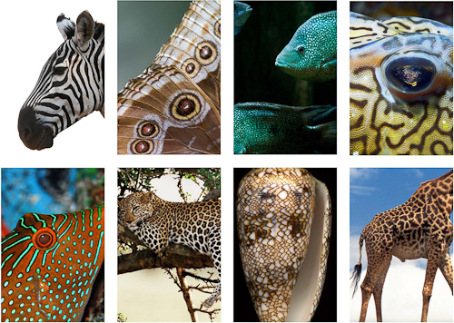
Mathematics and Computation in Biology
Notes:
http://n-e-r-v-o-u-s.com/education/simulation/ethworkshop.php “Reaction-Diffusion is a mathematical model of a theorized mechanism for biological pattern formation. “
Nature produces a wide array of complex yet regular patterns.
Biologists have determined that these patterns arise during embryonic development, but they still don’t know exactly how it all happens.
Because the patterns are so regular, they have often been considered mathematical problems – what formulas or equations could one produce that would explain how the patterns are developed.
For a long time (i.e. all the millenia before computers), proposed mathematical explanations were difficult to test – you make an equation, but then what? But with the advent of modern powerful computation, they are now testable through simulation. That is, you make your mathematical model, program it up as a prediction/simulation, let it run millions of times and see what happens.
This capability has advanced all of the hard sciences, and it has specifically shed some light on “how the leopard gets its spots”
One of the great things about being a coder is that you get to work on this stuff without having to have a biology degree. You just need to be able to understand the workings well enough to implement them.

Slide 23
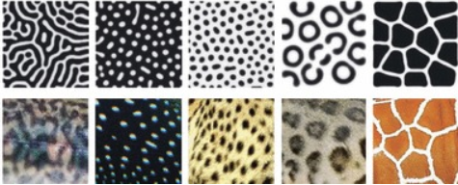
Gray-Scott Reaction Diffusion Models
Gray, P. and Scott, S.K., Chem. Eng. Sci. 38 29 (1983); 39, 1087 (1984); J. Phys. Chem.89 22 (1985).
Notes:
https://www.researchgate.net/figure/49645863_fig2_Figure-1-Reaction-diffusion-simulations-reproduce-color-patterns-found-in-nature-A
In the 1980’s Gray and Scott proposed a chemical mathematical model that they believed could explain how these animal patterns arise.
In the decades following, people were able to implement simulations of the model, and the patterns the simulations generated were remarkably similar to those found in nature.
In the image, you see animals in the bottom row, and patterns generated by the simulation in the top row.
The different patterns occur when the constants in the mathematical models are varied, as one would expect them to be in different animals.
Many people consider this to be evidence in support of the Gray-Scott diffusion model as an explanation for how the biological system works.
In your first assignment this semester, you are going to build a Gray-Scott simulator.

Slide 24
Diffusion-Reaction
Animal colouration is determined by the concentration of specific chemicals in the animal’s cells during embryonic development.
These chemicals spread out (diffusion) across the animal’s cells in a mathematically predictable way.
These chemicals react (reaction) with each other in a mathematically predictable way.
We will model a two-chemical system.
We will assign pixel colours based on the concentrations of these two chemicals.
We will observe the impact of varying equation parameters and algorithms on the patterns we generate.
Notes:
Very, very simplified...

Slide 25
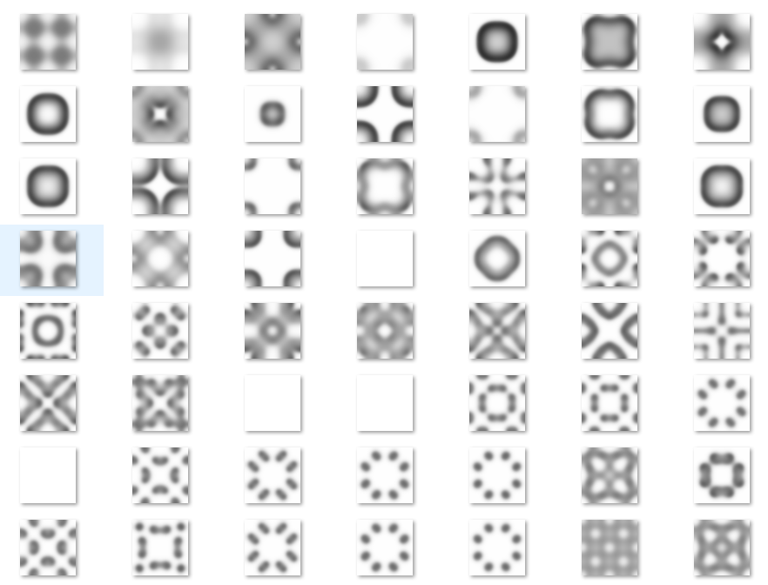
Examples
Notes:
From my solution, with different computational and shading algorithms...
These are 64 x 64 cell grids.
These all differ simply in the values of the equation parameters
This is what they look like when they reach a stable state
The different shades of grey represent different concentrations of the two chemicals in each grid cell
The plain white ones are where the stable state has one of the two chemicals completely taking over the whole grid.

Slide 26
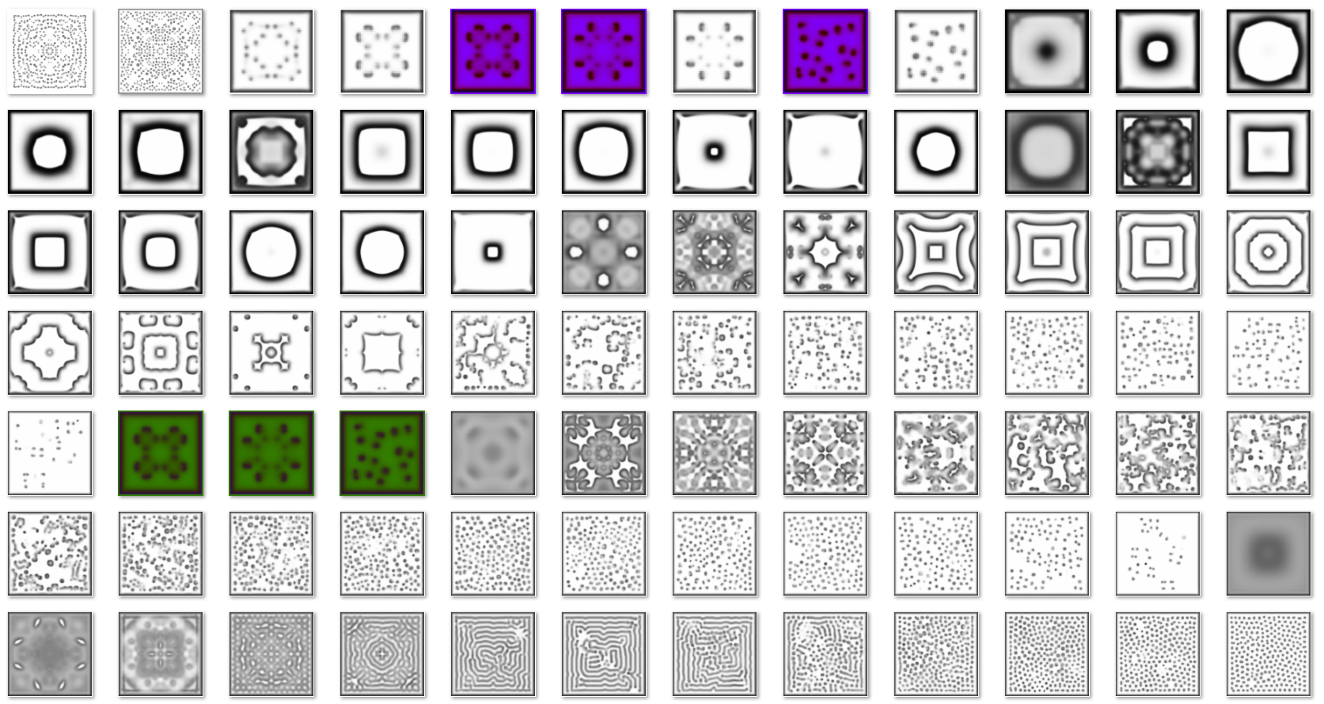
Examples
Notes:
From my solution, with different computational and shading algorithms...

Slide 27
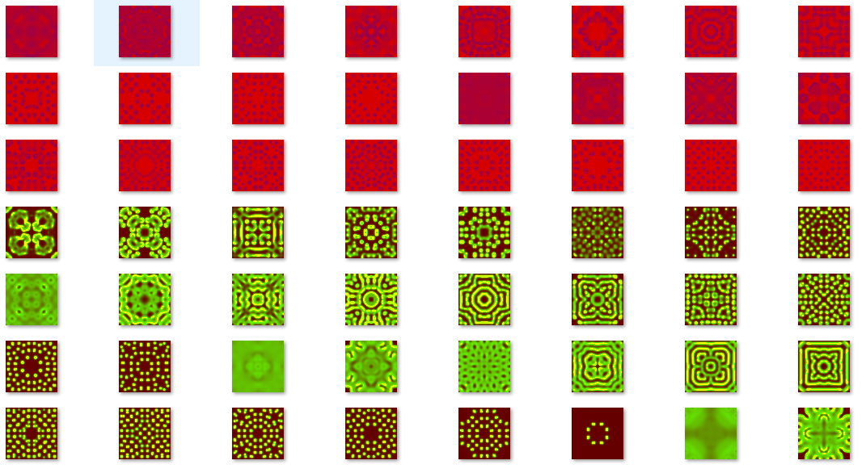
Examples

Slide 28
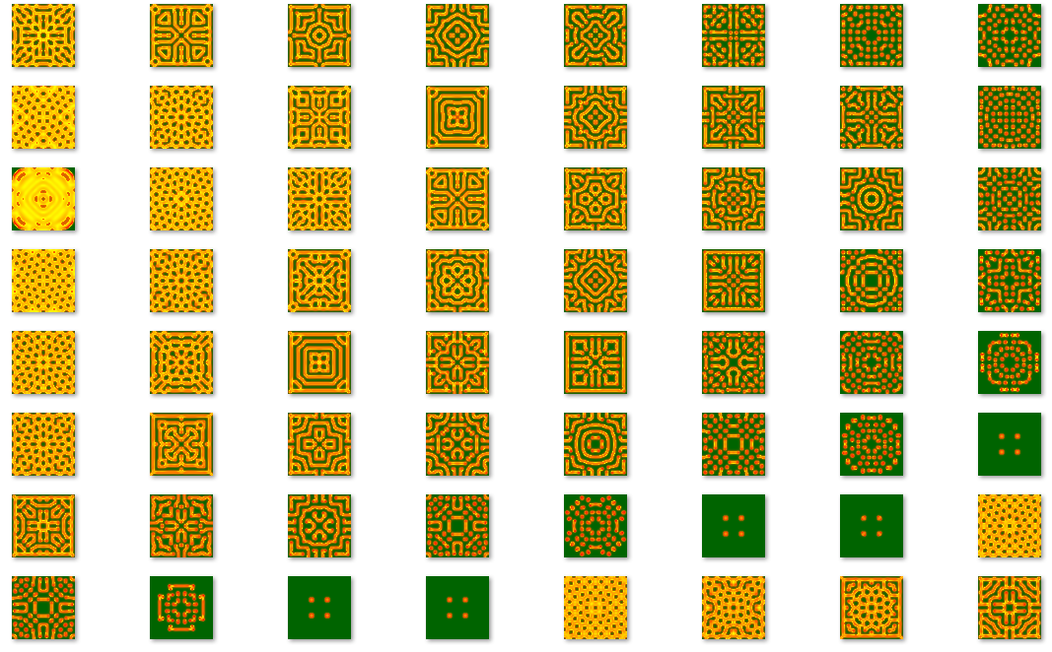
Examples
Notes:
Demo app...

Slide 29
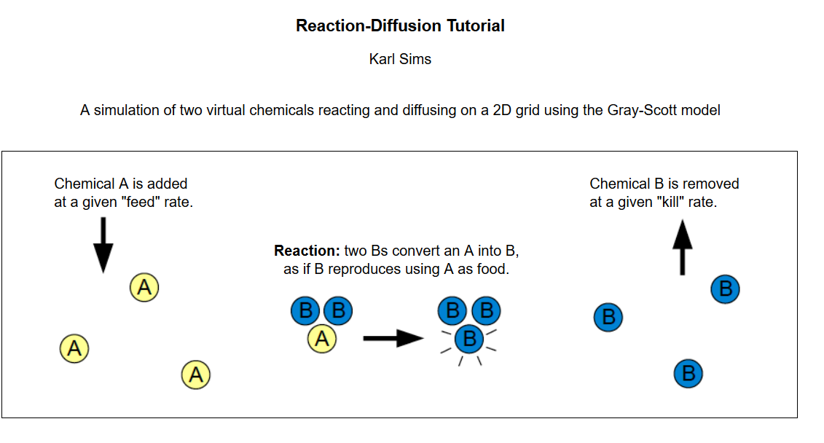
Gray-Scott
Notes:
http://www.karlsims.com/rd.html
Imagine the embryo as a collection of cells with a lot of chemicals swirling around in them. This is actually pretty realistic.
The model says that colouration is determined by the relative concentrations of just these two chemicals, A and B.
They swirl around and have chemical reactions, as shown.
The cell’s walls are permeable to A and B. Chemical A comes into a cell at some rate; chemical B exits the cell at some rate.
When they bump into each other in the right quantities, they have a chemical reaction => If two Bs and an A clump together, the A changes into a B (so you have three Bs).
Note that this immediately introduces some probability into the system → the more A there is, the more likely the Bs are to find it. So it is similar to predator-prey models, as indicated in the figure. Nature is parsimonious.

Slide 30
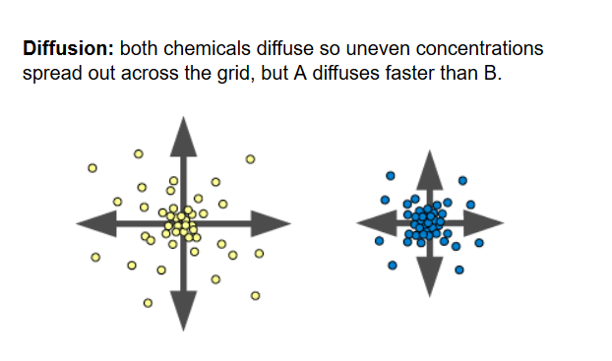
Gray-Scott
Notes:
At the same time all the reacting is going on, the chemicals diffuse by osmosis – the tendency of chemicals to want to spread out evenly.

Slide 31
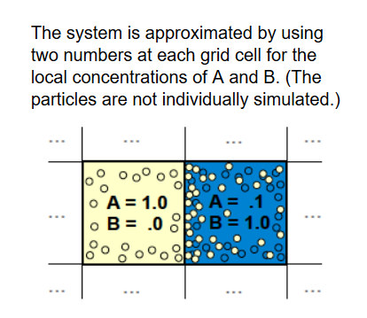
Gray-Scott Simulator
Notes:
To see the patterns, we only need to model the relative concentrations of A and B on a scale from 0 (none) to 1 (maximum possible)

Slide 32
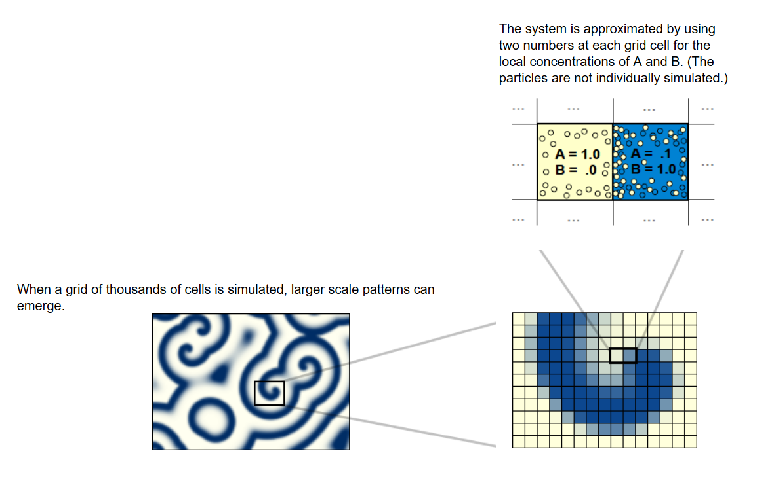
Gray-Scott Simulator
Notes:
This is what we are going to do.
We will build a grid of cells, determine the concentrations of A and B by using a formula and then colour the cells based on the concentrations of A and B.
The concentrations of A and B change over time as the chemicals feed in, die off, react and diffuse.
We will simulate time with a simple timer, updating the cells and their visual display at each timer tick.

Slide 33
The Equations
A_{t + 1} = A_{t} + (Diff_{A} * Lap(A_{t})) – A_{t}B_{t}² + (Feed_{A} * (1-A_{t}))
B_{t+1} = B_{t} + (Diff_{B} * Lap(B_{t})) + A_{t}B_{t}² – ((Kill_{B} + Feed_{A}) * B_{t})
Diff_{A}, Diff_{B}, Feed_{A} and Kill_{B} are simulation parameters.
They are set at the beginning of the simulation and do not change during that trial.
Lap(x) is the “Laplacian Function”, which is a measure of osmotic pressure (details in the handout).
Notes:
Lap(x) = “Laplacian function” which is a measure of osmosis. It is basically the difference between this cell’s concentration and the concentrations of its neighbours. If its neighbours are a lot lower than it, the chemical will diffuse fast. If its neighbours are nearly equal, it will diffuse more slowly. There are number of ways that mathematical biologists estimate this function. You will be given three different methods in the handout.
A and B are the concentrations of the two chemicals.
DiffA and DiffB are their diffusion rates
FeedA is the feed rate of A
KillB is the kill rate of B
The equations are actually pretty straightforward:
How much does A change?
It changes by its diffusion, which that first term will compute for us (decreases if the laplacian terms are negative; increases if they are positive). Just take that on faith.
The prob of 2 B and and A meeting up is A*B*B. When that happens, the A changes to a B, so we subtract this term.
Then we add in the feed rate, scaled by 1-A so that it can’t be bigger than 1 (because we are limiting our range to 0..1).
How much does B change?
The same, except that the reaction adds a B, and we subtract the Kill rate. (The addition of FeedA to KillB there just keeps the system from exploding).

Slide 34
The Equations
A_{t + 1} = A_{t} + (Diff_{A} * Lap(A_{t})) – A_{t}B_{t}² + (Feed_{A} * (1-A_{t}))
B_{t+1} = B_{t} + (Diff_{B} * Lap(B_{t})) + A_{t}B_{t}² – ((Kill_{B} + Feed_{A}) * B_{t})
At each timer tick, we compute the new values of A and B for each cell and re-colour the cells.
Eventually the levels of A and B will stabilise (no longer change). That’s what the animal would look like.
Different values of the parameters produce different stable patterns.
Notes:
Colouring algorithms in a minute
Note that you compute new values for all cells based on current cell values for the whole grid (specifically for neighbours), then update all at once. You don’t make a rolling change.
Stability happens at different points for different parameter values.

Slide 35
Implementation
An n x n grid of cells, 16 <= n <= 256
Each cell has a concentration of A and of B
Update the concentrations of each cell at each timer tick.
Two step process:
Compute the new concentration values for all cells
Update all cells
Simulation begins with all grid cells at A=1, B=0.
Seed a small area of cells with B=1, A=0
Notes:
More details in handout, but this is the basic approach.
You can get patterns with as little as 16x16, but the good ones require at least 64x64, and they continue to get better up to 256 x 256. Bigger than that takes too long to run.
Two steps because: The Laplacian formula uses the chemical concentrations of the neighbours, so it matters if you change as you go. Don’t change as you go.
The seeded area is often placed symetrically in the centre, but you should feel free to experiment with off-center areas, multiple areas, etc.

Slide 36
Parameter Values
Diff_{A} and Diff_{B} depend on which Laplacian function you use (see handout)
The following pairs of Feed_{A} and Kill_{B} values should generate interesting patterns for all three Laplacian functions in 5000 time steps.
Feed _{A} | Kill_{B}
.025 | .056
.032 | .061
.021 | .058
Notes:
Use these for testing your implementation to see if it is making sense.

Slide 37
Additional Requirements
No group work
Three Laplacian functions (see handout)
At least three colouring algorithms (see next slides)
Appropriate user interface to allow manipulation of simulation parameters and display.
Facility for saving grids as image files.
Facility for automating simulations to explore the solution space.
Notes:
You’re going to need to look at the effects of the various combinations of parameter values. You won’t want to do this by hand...

Slide 38
Shading Algorithms
Use the .NET Graphics class.
Each cell is painted a single colour (FillRectangle)
Based on concentration of one of the chemicals.
Must convert a scalar (value between 0 and 1) into an RGB value.
Many, many available algorithms.
Notes:
T

Slide 39
Shading Algorithms
Simplest: Grayscale
Let x = (Concentration of B) * 255
Let y = Floor(x)
Brush colour is RGB(y,y,y)

Slide 40
Shading Algorithms
More interesting
Converting Scalars to RGB Colormap https://www.particleincell.com/2014/colormap/

Slide 41
Architecture
Correct classes and interfaces (if appropriate)
Correct SRP
Correct Open/Closed
Correct modularity
Cohesive
Uncoupled
Strategy, Factory and Subject/Observer design patterns used (or not used) as appropriate.
Notes:
Detailed marking rubric in the handout.

Slide 42
Rubric
Component | Weight
Architecture | 30%
Code elegance and correctness | 30%
Commenting | 5%
Functionality & Robustness | 30%
User Interface | 5%
Notes:
“Robustness” = bugs

Slide 43
Submission Requirements
Deliverables:
Running implementation, written in C#
Word document showing image files for 10 distinct patterns, specifying parameter values, number of time steps and Laplacian algorithm used.
All work to OP GitBucket repo
Minimum of two commits each week.
Note that success with this assignment depends very heavily on carefully following the spec.
Note that after your simulator is working, you will need a lot of time (possibly several days) to run your automated trials to explore the solution space. Plan your schedule accordingly.
Notes:
To find your interesting patterns, you will need to explore the whole range of parameter values.
You will absolutely need to automate this.
If you haven’t done anything, that’s your commit message.
Read the spec very carefully. Plan ahead very carefully.

Slide 44
Permissible Googling
Do as much research into Gray-Scott and its implementations as you wish.
Submit ONLY original code.
Be prepared to explain your code in laborious detail if asked.
Notes:
No copy-paste
No robo-coding.

